Slide 1

Understanding
5G Architecture
Building the Future of Connectivity

Slide 2

Introduction
5G stands for the fifth generation of wireless technology.
It builds upon the foundation of 4G LTE, offering faster speeds, lower latency, and increased capacity.
5G is not just an upgrade; it's a transformative technology to revolutionize communication, connectivity, and various industries.
5G is mainly deployed in two service Architecture models that is Stand Alone (SA) and Non-Stand Alone (NSA) Architecture.

Slide 3
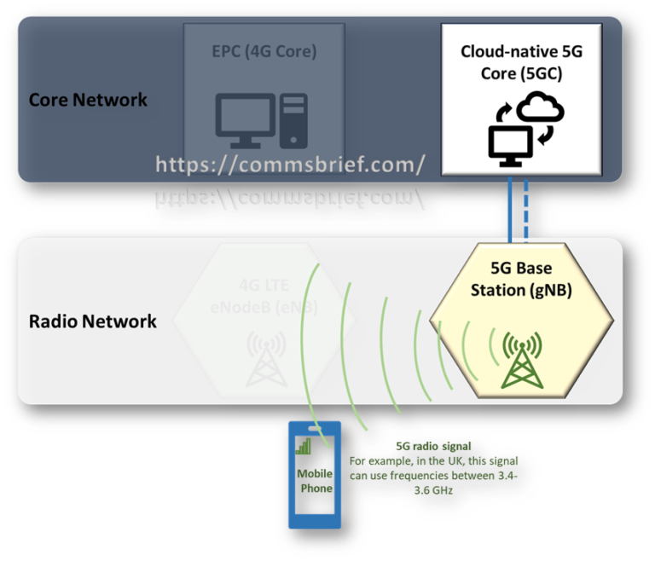
Stand Alone Architectural model
In the Stand Alone model, 5G operates as a self-sufficient network, leveraging a cloud-native core and a service-based architecture to deliver seamless connectivity. The gNodeB acts as the cornerstone, ensuring robust communication between devices and towers.

Slide 4
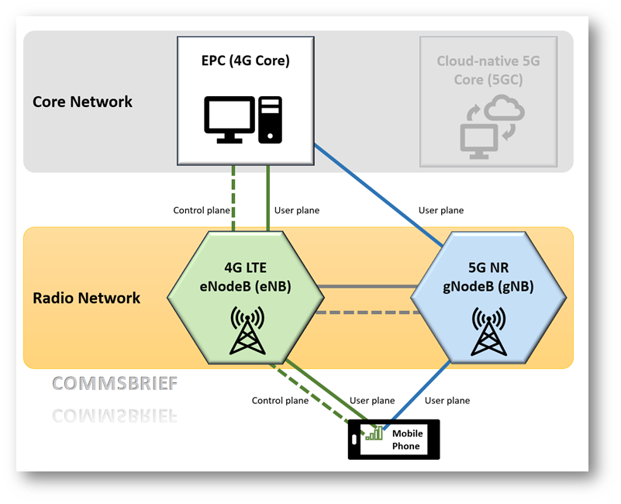
Non-Stand Alone Architectural
model
Where as the Non-Stand Alone model builds upon existing infrastructure, integrating with the 4G core network to extend connectivity capabilities. Here, the ng-eNodeB serves as a vital link, enabling seamless communication between 4G and 5G devices.

Slide 5
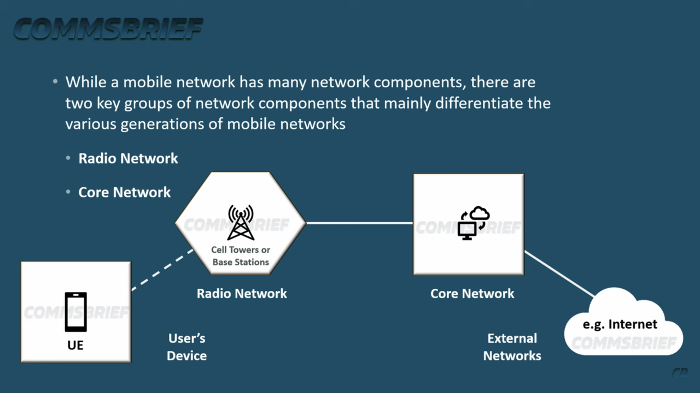
Understanding Network
Architecture

Slide 6
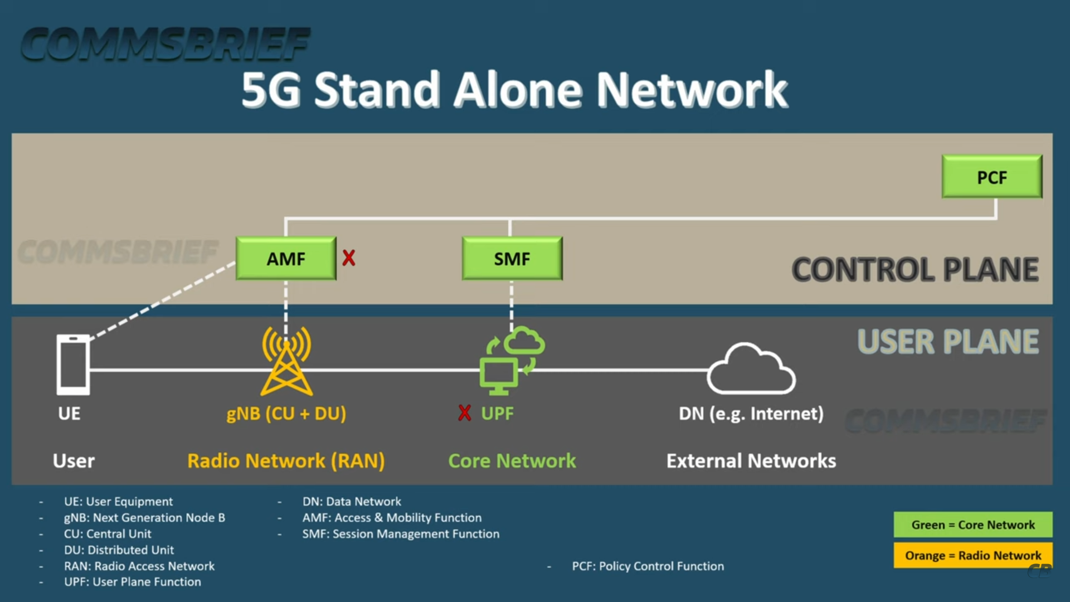
Understanding Core Network
Architecture
Suppose we have the User Equipment eager to connect to the Radio Access Network so in the base station we have gNodeB which serves as the central hub managing the flow of data between user equipment and external networks

Slide 7
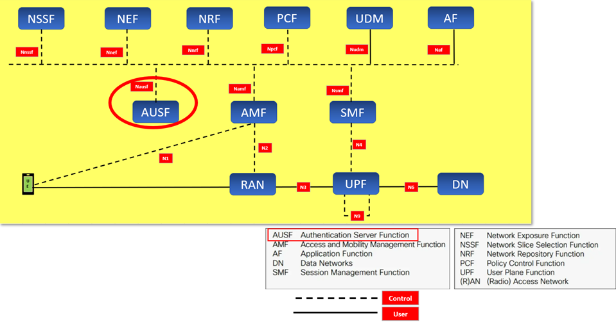
Access and Mobility Management
Function (AMF)
It manages mobility within the network, handling procedures such as handovers between cells and mobility between different access technologies.

Slide 8
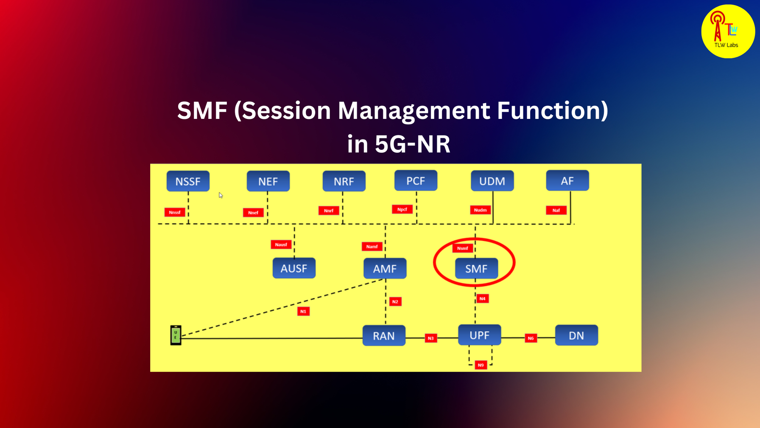
Session Management Function (SMF)
The AMF initiates, maintains, and terminates user sessions within the 5G network, ensuring seamless connectivity for users as they move between different locations

Slide 9
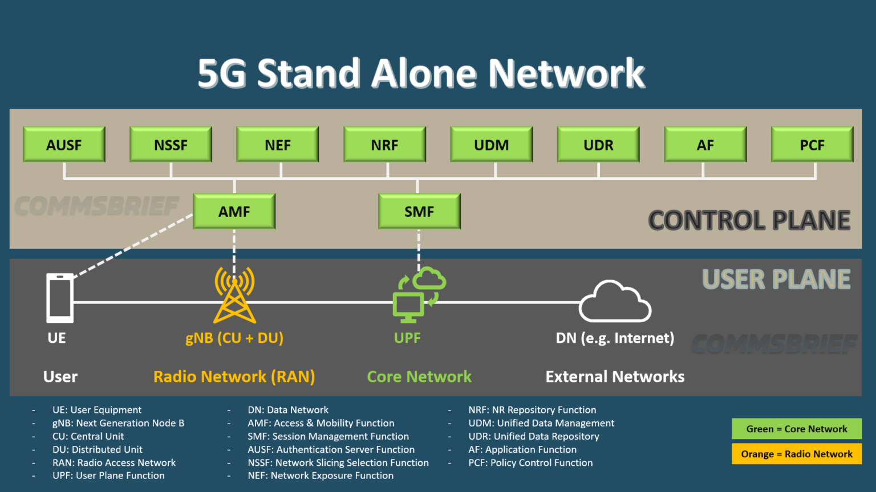
Authentication Server Function (AUSF)
The AUSF verifies subscriber identity and credentials for network access, while Authorization ensures subscriber privileges for network functions.

Slide 10
Network Slice Selection Function (NSSF)
The Network Slice Selection Function (NSSF) orchestrates network slice selection, ensuring optimal resource allocation and performance tailored to specific user requirements within the 5G network.

Slide 11
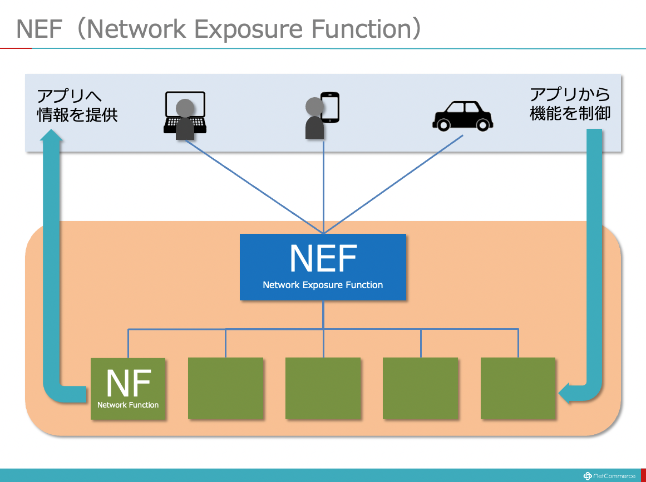
Network Exposure Function (NEF)
The Network Exposure Function (NEF) enables secure and controlled access to network data and services, facilitating seamless integration with external applications and services within the 5G network.

Slide 12
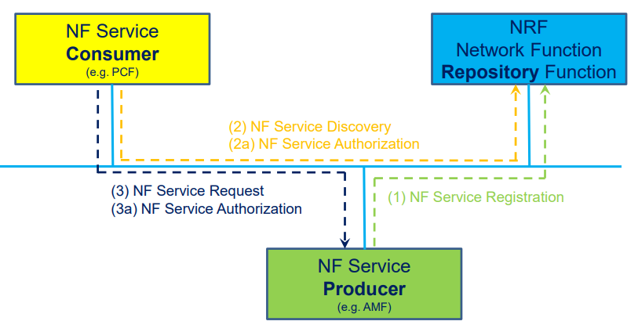
The Network Repository Function (NRF)
The Network Repository Function (NRF) serves as a centralized repository for network function information, facilitating dynamic discovery and selection of network functions within the 5G network architecture.

Slide 13
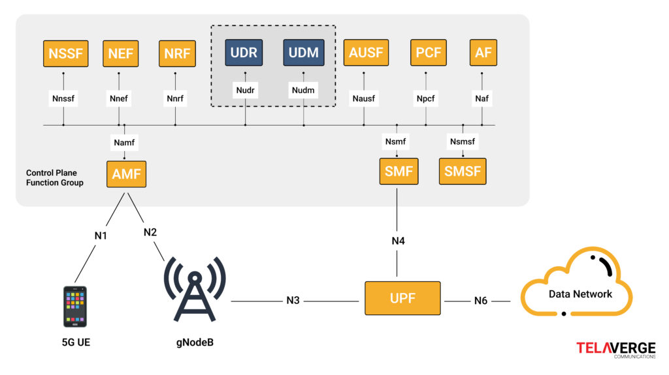
Unified Data Management (UDM)
The Unified Data Management (UDM) function centralizes and manages subscriber data and profiles, ensuring secure access and efficient utilization of data across the 5G network.

Slide 14
User Data Repository (UDR)
The User Data Repository (UDR) stores and manages subscriber-related data, including subscription profiles and service-related information, ensuring efficient access and utilization within the 5G network architecture.

Slide 15
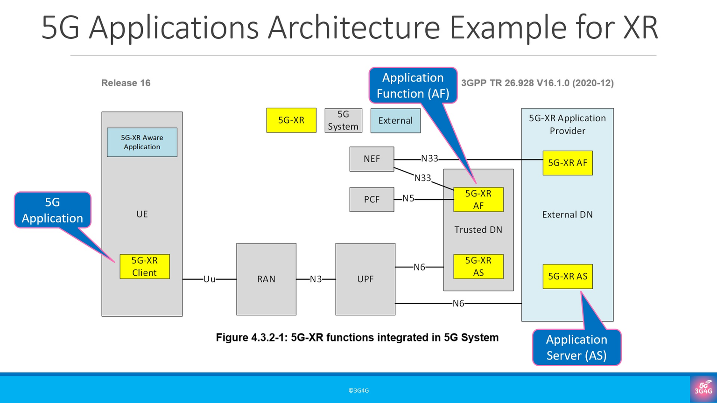
Application Function (AF)
The Application Function (AF) enables the deployment and management of network applications and services, facilitating interaction between users and network resources within the 5G architecture.

Slide 16
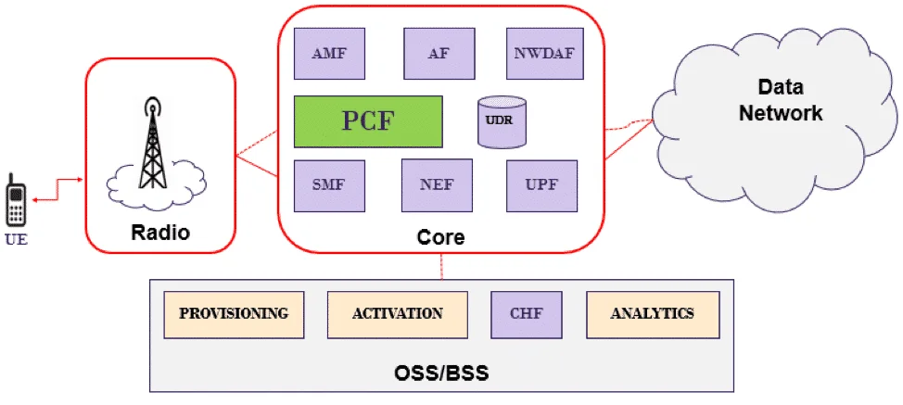
Policy Control Function (PCF)
The Policy Control Function (PCF) oversees the enforcement of network policies, ensuring efficient resource allocation, quality of service management, and security measures within the 5G network.

Slide 17
CONCLUSION
we've explored the key components of 5G architecture. 5G isn't just about faster speeds; it's about building a robust infrastructure that will shape the future of connectivity and drive innovation across various industries.

Slide 18
THANK YOU

